Slide 1
EMOJI PREDICTION ON TWITTER DATA
- Nese Tirki
- Charishma Choudary Tummala

Slide 2
AGENDA
Introduction
Objective
Data
Cleaning and Pre-processing
CountVectorizer
Machine Learning approach
Text Tokenization
Deep Learning approach
Outcome
Emoji Prediction
Conclusion

Slide 3
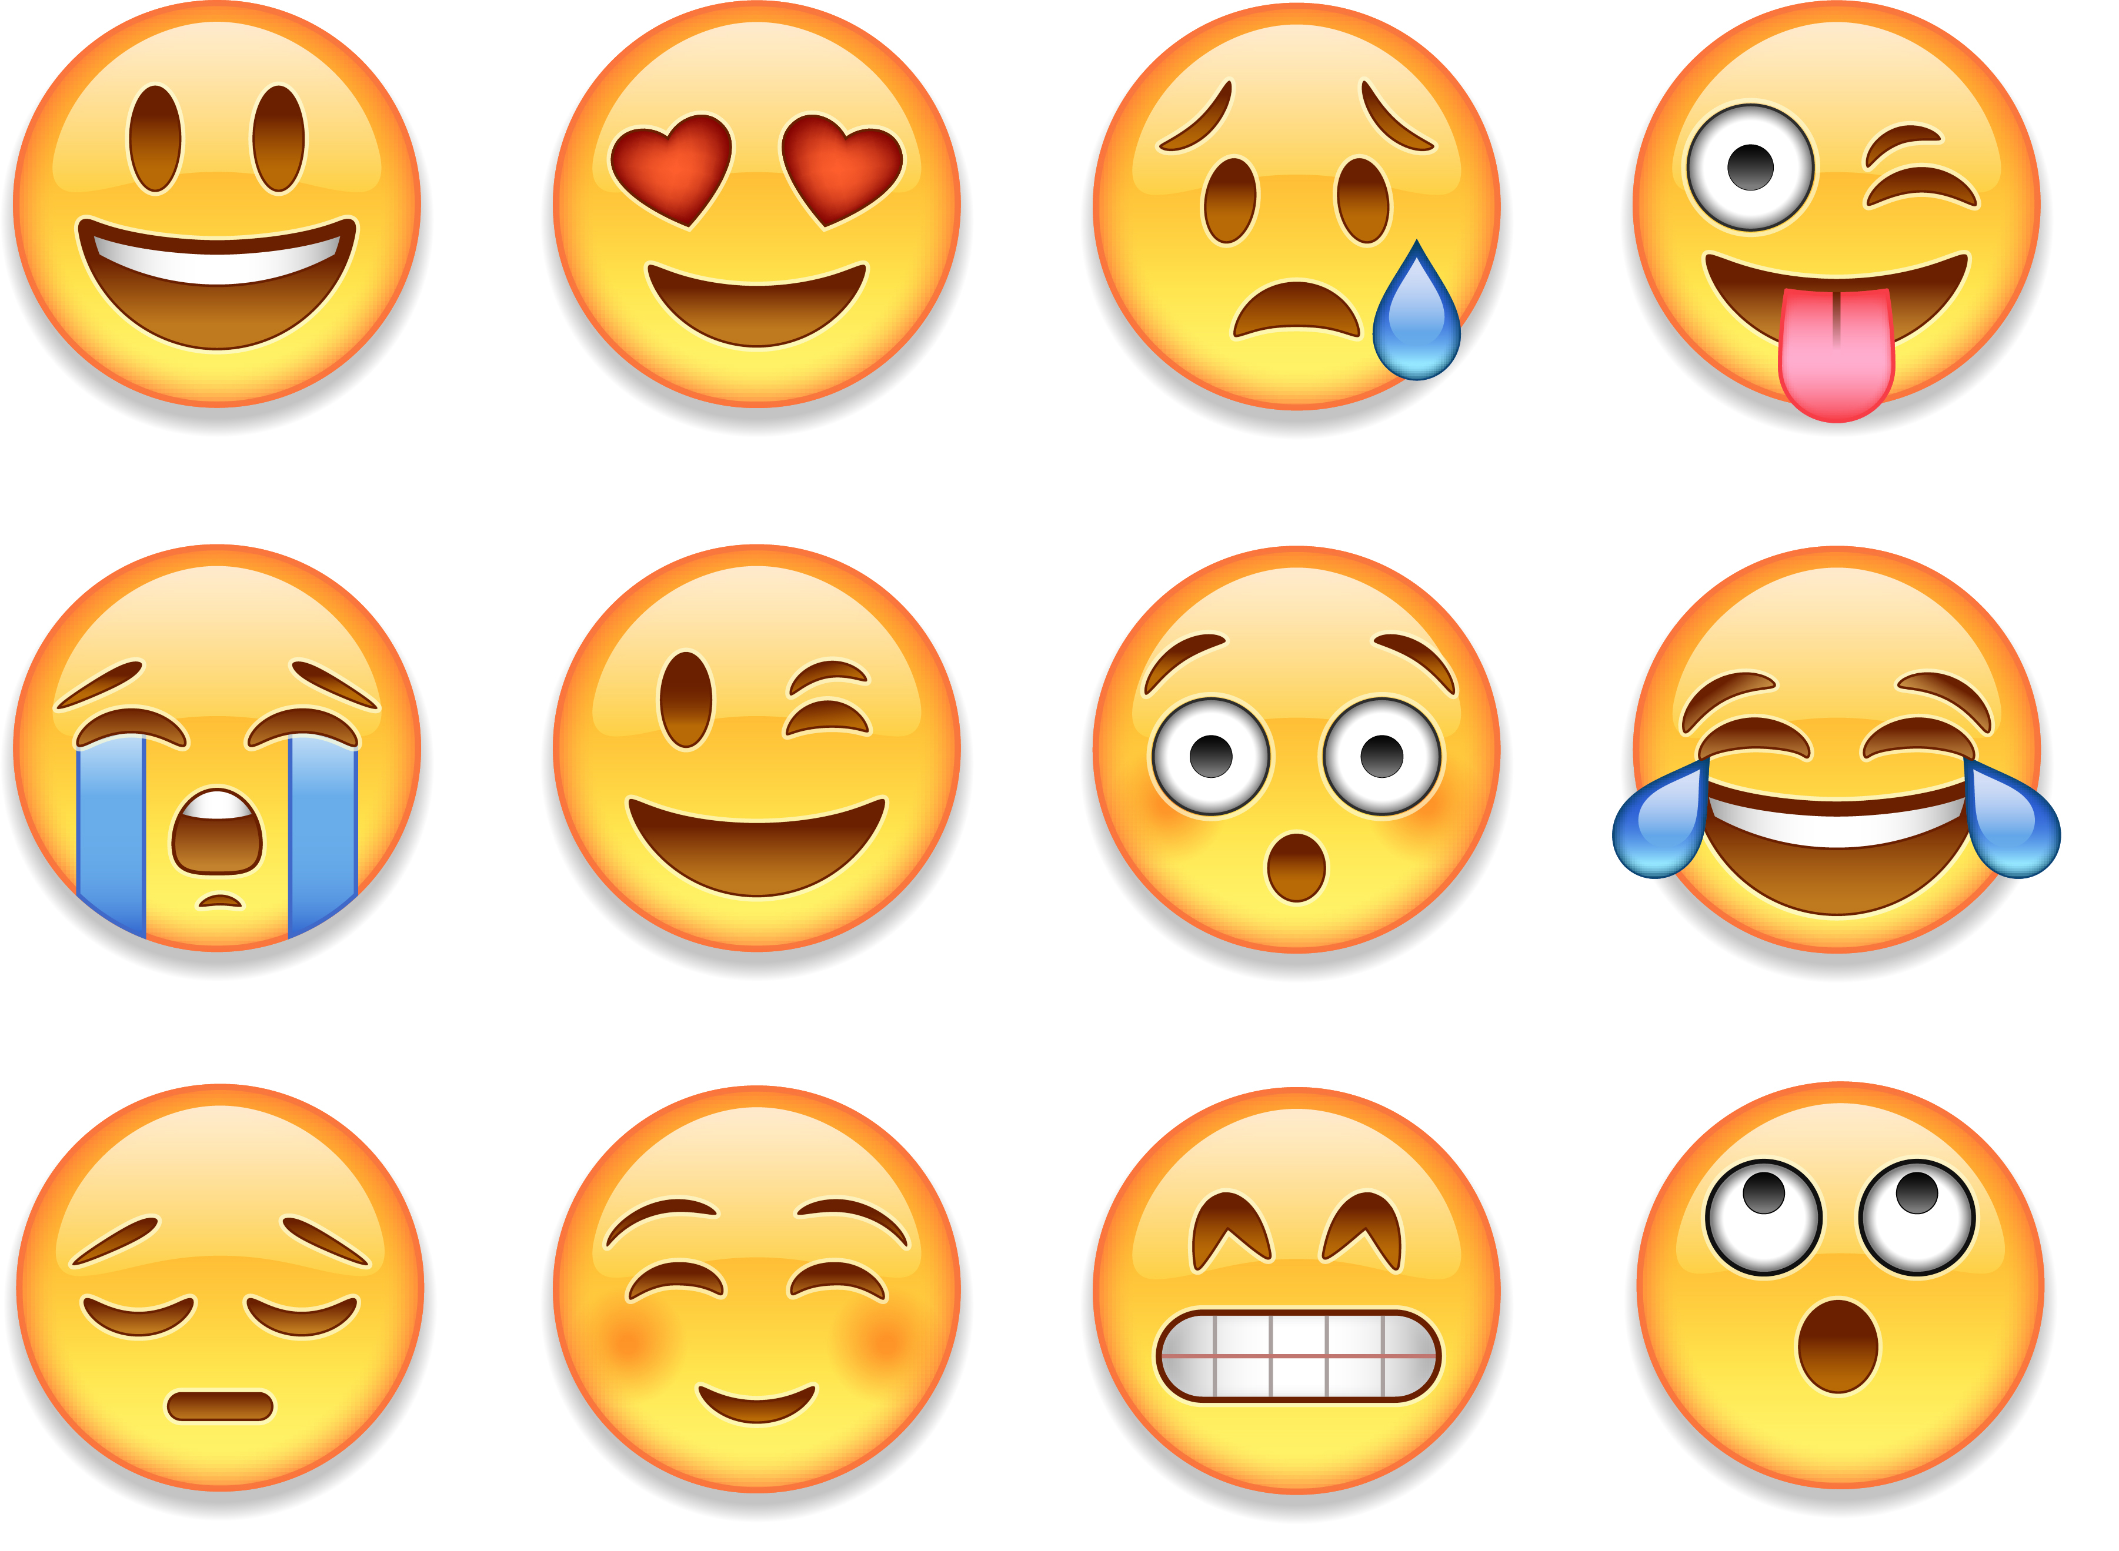
Introduction
Emojis are tiny, pictorial representations of feelings or objects that are frequently used in text messages to improve interpersonal communication.
Emojis help to display facial expressions, tone of voice, and human gestures in digital communication.
Our brains see emojis like a human face. So, we subconsciously associate seeing an emoji with face-to-face communication.
In fact, you could say emojis are more engaging than text because they are closer to replicating a real-life conversation.

Slide 4
Objective
The main objective here is to identify the relationship between the text messages and the emojis used in them.
Data gathering, pre-processing, model development, model training, and model evaluation are the project's phases.
The goal of the model we create is to comprehend the text sentence's underlying semantics utilizing natural processing and deep learning approaches to forecast emojis that make sense.

Slide 5
DATA
There are two datasets in total, one is the twitter dataset which consists of of 50,000 tweets and their corresponding emoji labels. So, here it consists of 50,000 observations and 2 columns("Tweet" and "Label").
Similarly, there is one more dataset where each label corresponds to an individual emoji. The labels run from 0 to 19, and the emojis are among the 20 most popular emotions.

Slide 6
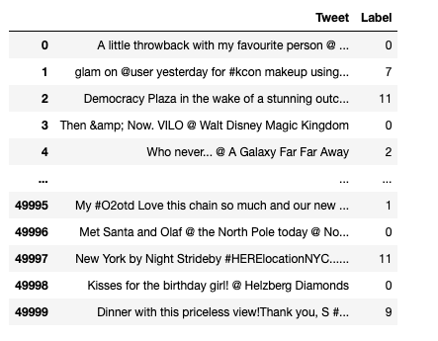
Twitter Dataset

Slide 7
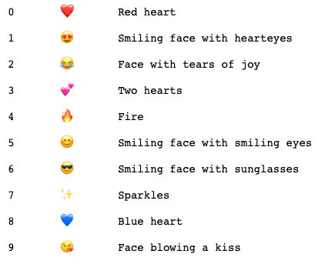
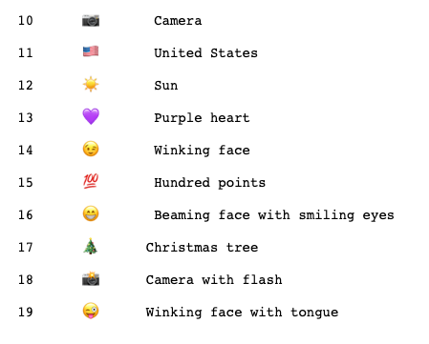
Emoji Dataset

Slide 8
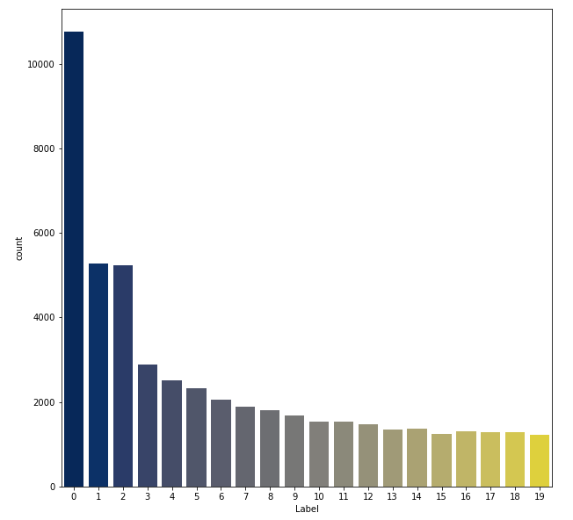
Distribution of Labels using EDA

Slide 9
Cleaning the data
Tweet texts often consists of other user mentions(@), hyperlink texts, and punctuations. The tweets are checked for duplicates, and any that are repeating themselves more than once are removed.
Initially, for convenience, all capital letters have been removed from the text.
All retweet tags(RT), user mentions (@user), and hashtag symbols (#) has been removed.
All hyperlinks has been removed
All tweets containing numbers has been removed
All punctuations in the tweets has been removed

Slide 10
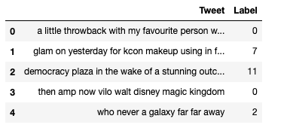
After Cleaning the data

Slide 11
Pre-processing Tweets
Commonly used terms like "a," "an," and "the," also known as stop words, are typically found in natural language used by individuals to communicate. Prior to performing any additional text processing, these words should be removed because they barely contribute to the sentence's meaning.
The text is next subjected to lemmatization, which, in contrast to stemming, which merely does word reduction, identifies the root word that belongs to the same language. Lemmatization is preferred over stemming since it is often more informative. When the words "eat," "ate," and "eaten" are lemmatized, only the word "eat" remains as the common lemma.
We used spacy as part of tokenization in order to perform removal of stop words and lemmatization of tweet.

Slide 12
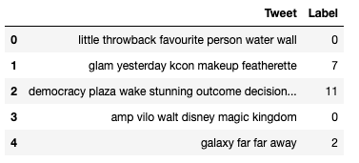
After Pre-processing the data

Slide 13
CountVectorizer for Text Feature Extraction
Since machine learning algorithms cannot read raw text data, we must perform feature extraction on the text input in order to produce numerical feature vectors.
In essence, count vectorization converts each word's frequency in a text to a number. The algorithms vectorize each text and count the number of times each unique word appears.
Consequently, a document term matrix is produced that maintains track of the word counts for each word used in the vocabulary of each text document.

Slide 14
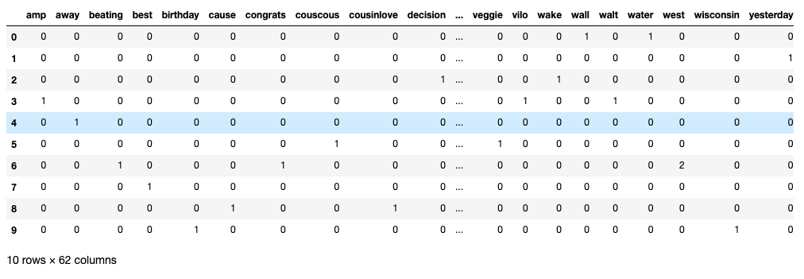
Sample 10rows of CountVectorization

Slide 15
Machine learning approach
We chose to utilize classification models because they work well with discrete features like word counts for text classification. Considering this, we have used the following models.
Multinomial Naive Bayes
Support Vector Machine
LogisticRegression
Decision Tree
Random Forest
XGBoost

Slide 16
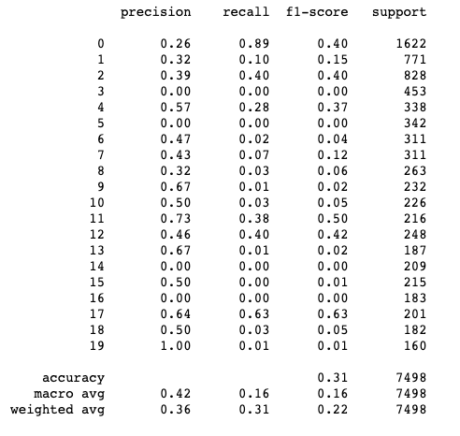
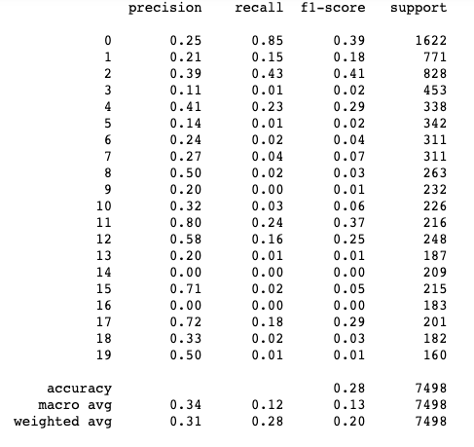
Model Evaluation Using Classification Report SVM Multinomial Naïve Bayes

Slide 17
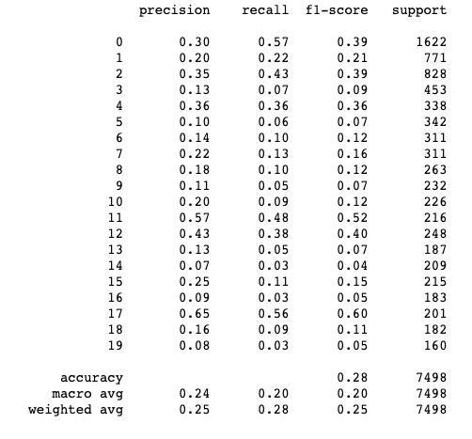
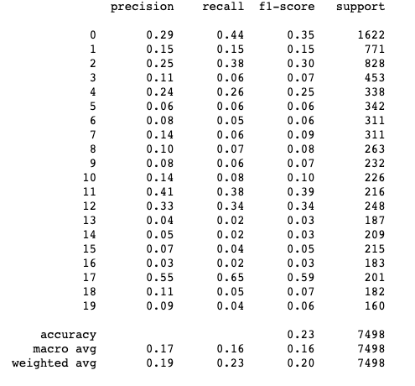
Model Evaluation Using Classification Report LogisticRegression DecisionTree

Slide 18
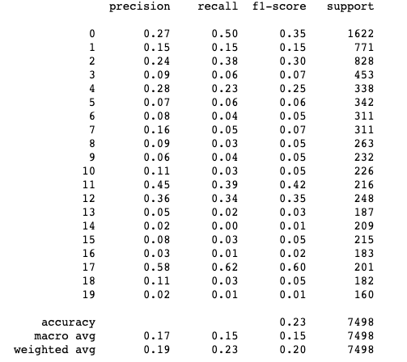
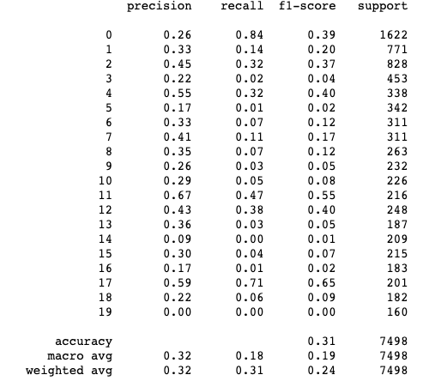
Model Evaluation Using Classification Report RandomForest XGBoost

Slide 19
Results from Machine Learning approach
The performance of the Support Vector Machine and XGBoost Classifier models was slightly better than that of the other models, demonstrating the ability to identify certain correlations.
However, overall, the accuracy results were lower, and the model's bias toward weights rather than text context is its main issue. This indicates that the model has a poor understanding of the semantic relationship between the sentence's and the emoji's word meanings.

Slide 20
Text Tokenization For Deep Learning
Initially, the standard text preparation techniques are used to remove any noise from the data, such as hashtags, mentions, hyperlinks, punctuations etc.,
Now Each document is subjected to text tokenization, which enables vectorization of the entire text corpus by converting each text document into a series of integers. These numbers are the indices in a word dictionary that correspond to a specific token.
Example,
Document → little throwback with my favorite person
Sequence → [8 , 72, 47, 11, 16, 45 ]
Lastly, we will be performing the padding of sequences because each document consist of different length of sequence which is not suitable for deep learning

Slide 21
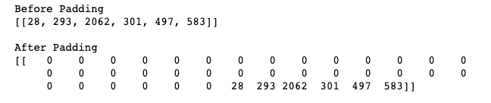
Padding results

Slide 22
Difference b/w tokenization used in pre-processing and in deep learning
In pre-processing we have implemented tokenization as a process to remove stop words and to lemmatize the tweets.
In deep learning we have approached for ’Text Tokenization’ where it allows the document to form in a sequence(series of integers) whereas in pre-processing there is no formation of sequence appearing for a set of tokens.

Slide 23
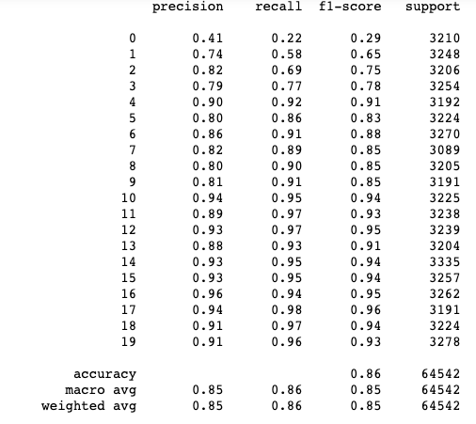
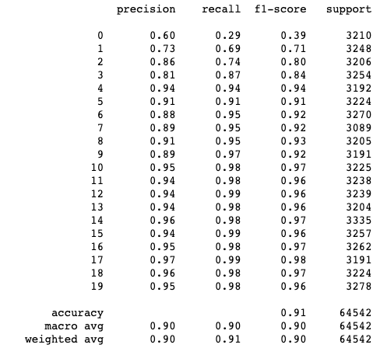
Model Evaluation for Deep Learning
LSTM
BI-LSTM

Slide 24
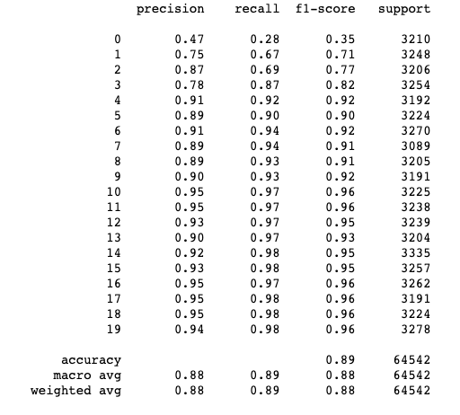
Model Evaluation for Deep Learning
RNN

Slide 25
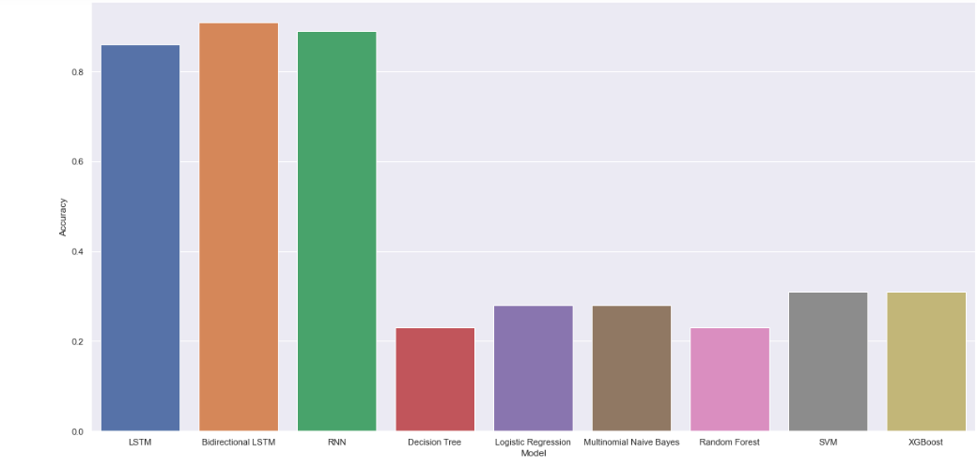
Outcome of the models

Slide 26
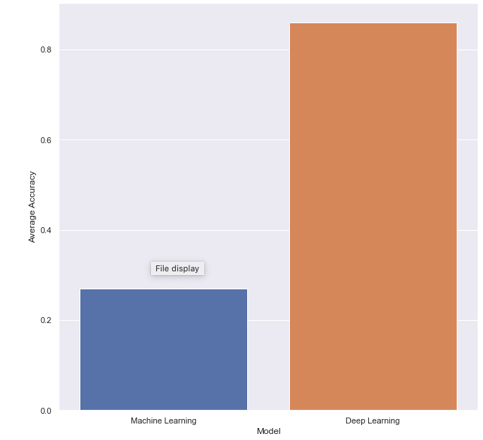
Comparison of avg accuracy of the models

Slide 27
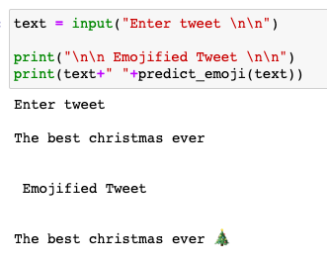
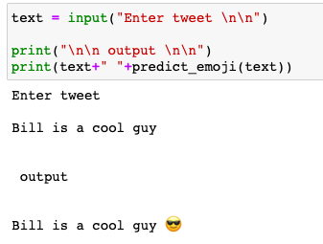
Emoji Prediction for the best accuracy model

Slide 28
Conclusion
Machine learning algorithms have the drawback of attempting to divide each class along a line rather of identifying semantic relationships.
Best Model - Bi-Directional LSTM (Deep learning approach)
Accuracy – 91%

Slide 29
THANK YOU

